Slide 1
When uncertainty is too big
Business Intelligence & Analytics

Slide 2
Cost benefit analysis
Often the future cash flows are difficult (or impossible) to calculate
How do we justify the project?
Use cost/benefit analysis
Descriptive portion
Cost/benefit analysis itself

Slide 3
Descriptive portion
Title
Current status
Consequences of not implementing
Critical success factors
Target group for results
Risks

Slide 4
Notes regarding descriptive portion
Be sure that all descriptions are accurate and take into account multiple views
Avoid negative language (could be seen as a political move)
Avoid being too dramatic about consequences of not implementing the initiative
Always have multiple parties review before the report is made official

Slide 5
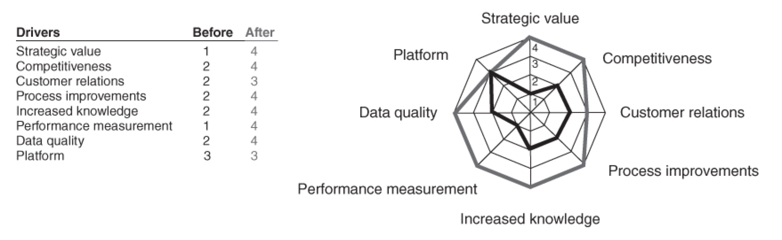
Cost/benefit analysis
Determination of drivers is somewhat subjective, be aware that it could be critiqued
Be specific about the scales used (as in the example)
Adding a visualization is a nice touch

Slide 6
Cost/benefit analysis as an alternative to NPV calculations
Some advice on how to write them

Slide 7


